Slide 1

WEBSITE DEVELOPMENT PROJECT
DELIVERY ONLINE

Slide 2
PATTERN WEBSITE

Slide 3
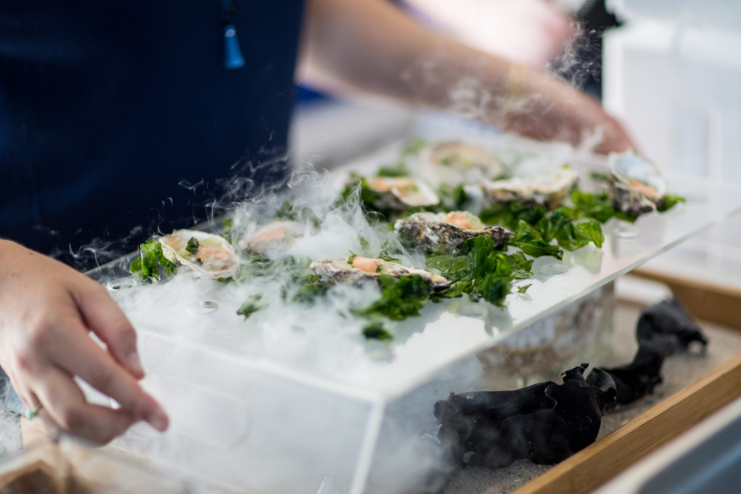
HOMEPAGE
HOME
FOOD
MEMBER
CONTACT
LOGIN
SIGNUP !

Slide 4
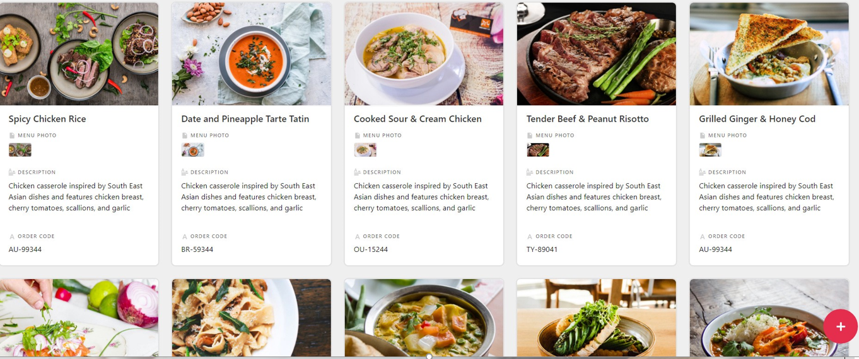
FOOD PAGE
HOME
FOOD
MEMBER
CONTACT
WELCOME : JOSH WISH

Slide 5
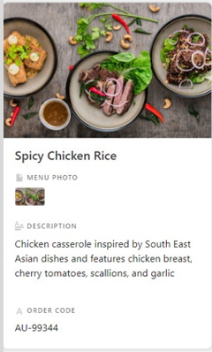
FOOD PAGE
HOME
FOOD
MEMBER
CONTACT
WELCOME : JOSH WISH
SPICY CHICKEN RESTAURANT
(149BATH) Spicy Chicken Rice [ + ]
(49BATH) PEPSI BOTTLE 149ml [ + ]
(199BATH) HOT Chicken Rice [ + ]
(49BATH) COKE BOTTLE 149ml[ + ]
(249BATH) Bonchon Chicken Rice [ + ]
(49BATH) SPRISH BOTTLE 149ml[ + ]
CONFIRM ORDER
CANCEL ORDER

Slide 6
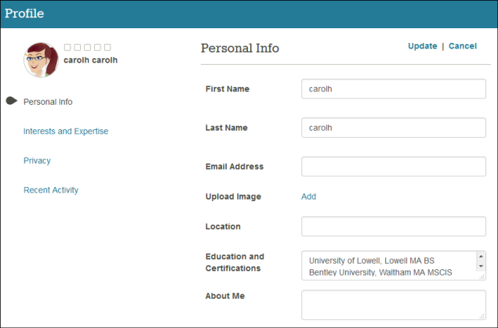
MEMBER
HOME
FOOD
MEMBER
CONTACT
WELCOME : CAROLH CAROLH

Slide 7
ADMIN
HOME
FOOD
MEMBER
CONTACT
WELCOME : ADMIN
ORDER NO.
MENU
CUSTOMER NAME.
ADDRESS CUSTOMER
156489789
- SPICY CHICKEN [149BATH]
WATTSON SMITH.
REGENT HOME BANGSON
156483221
- COKE BOTTLE 49ml [49BATH]
CHOTI BOI
SUPALAI VERENDA TAOPOON
156489424
- SUSHI x SALMON [999BATH]
LOBA APEX
PARKLAND WONGSAWANG

Slide 8
CONTACT
HOME
FOOD
MEMBER
CONTACT
CALL-CENTER : 0646356524
FACEBOOK : DELIVERY ONLINE

Slide 9
MEMBER
6104062630077 นายธนัท พรหมพิริยา
หน้าที่ : FRONT-END
6104062630590 จตุรภัทร จันทรังษ์
หน้าที่ : BACK-END
610406263 โชติ วงบุศกร
หน้าที่ : SUPPORT BACK-END

